Slide 1
The Release Pipeline in Practice
Graduating from the School of Michael Greene
ANY SUPPORTING CODE AND DOCUMENTATION AT https://github.com/matthitchcock/PSConfEU17-ReleasePipelineinPractice
Matt Hitchcock, Senior Consultant @ Microsoft Singapore

Slide 2
Agenda
Introduction
Background on the Release Pipeline
How a Release Pipeline works and example architecture
My experiences implementing with a Customer
Summary

Slide 3
TL;DR
The Release Pipeline Whitepaper and Demo CI repo give you a good start for starting an Infra-as-Code initiative, but when you move to a Production scenario, you run into some challenges that will hold you up. These take time to get through, so progress on your first project can be slow. Also, the more people you're changing, the more you're time this will take, not everyone will be as thrilled as you but if you keep at it, good things will come.
Automation is magical :D

Slide 4
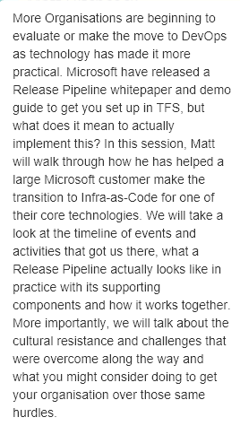
The best laid plans of mice and men …
In this session, Matt will:
Walk through how he has helped is helping a large Microsoft customer make the transition to Infra-as-Code
We will take a look at the timeline of events and activities that got us there to where we currently are
We will talk about cultural resistance and challenges that were overcome that we are working through

Slide 5
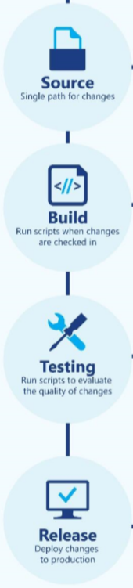
What the Release Pipeline (and Demo_CI) is
A Process, a Workflow that will take your Code Changes from a Repository to Production
It automates your Testing to provide Fast Feedback of issues
It’s a developer system of work that as we do Infra-as-Code or Configuration Management, is relevant to Operations too
Demo_CI enables you to build a starting Demo for Infra-as-Code using Microsoft tools

Slide 6
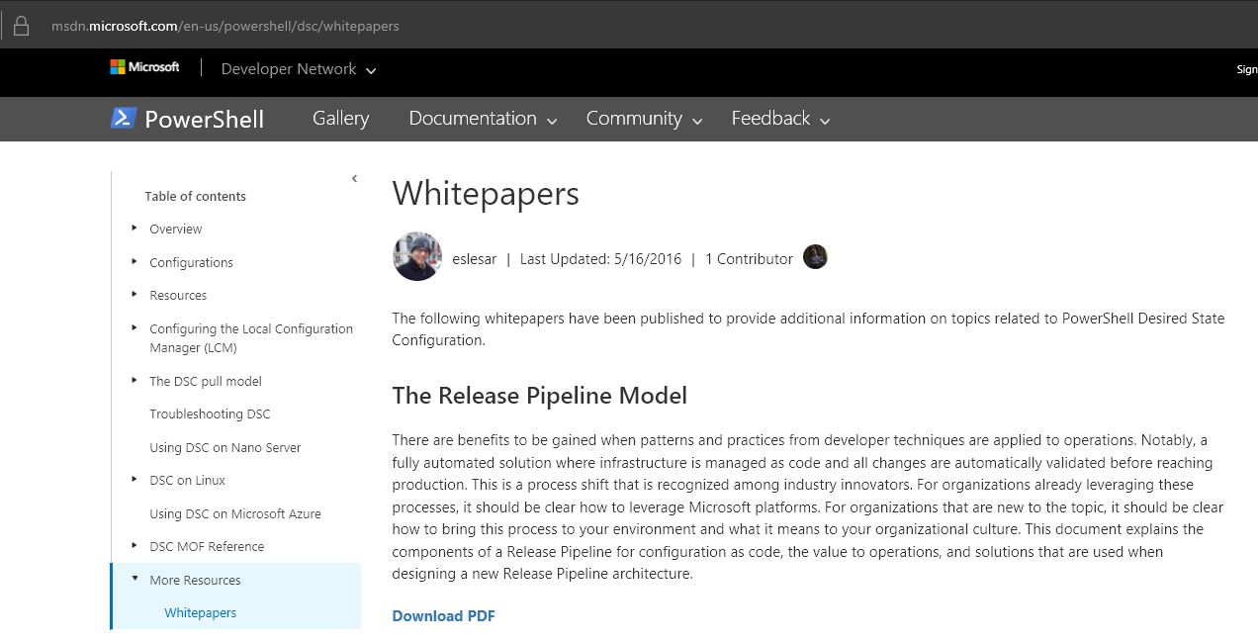
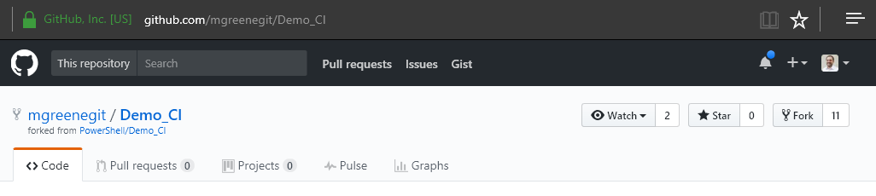
Introducing the Release Pipeline
https://aka.ms/trpm
https://github.com/mgreenegit/Demo_CI

Slide 7

Still unanswered questions, feels a bit …
https://img.youtube.com/vi/J1gAHil89Z4/0.jpg

Slide 8
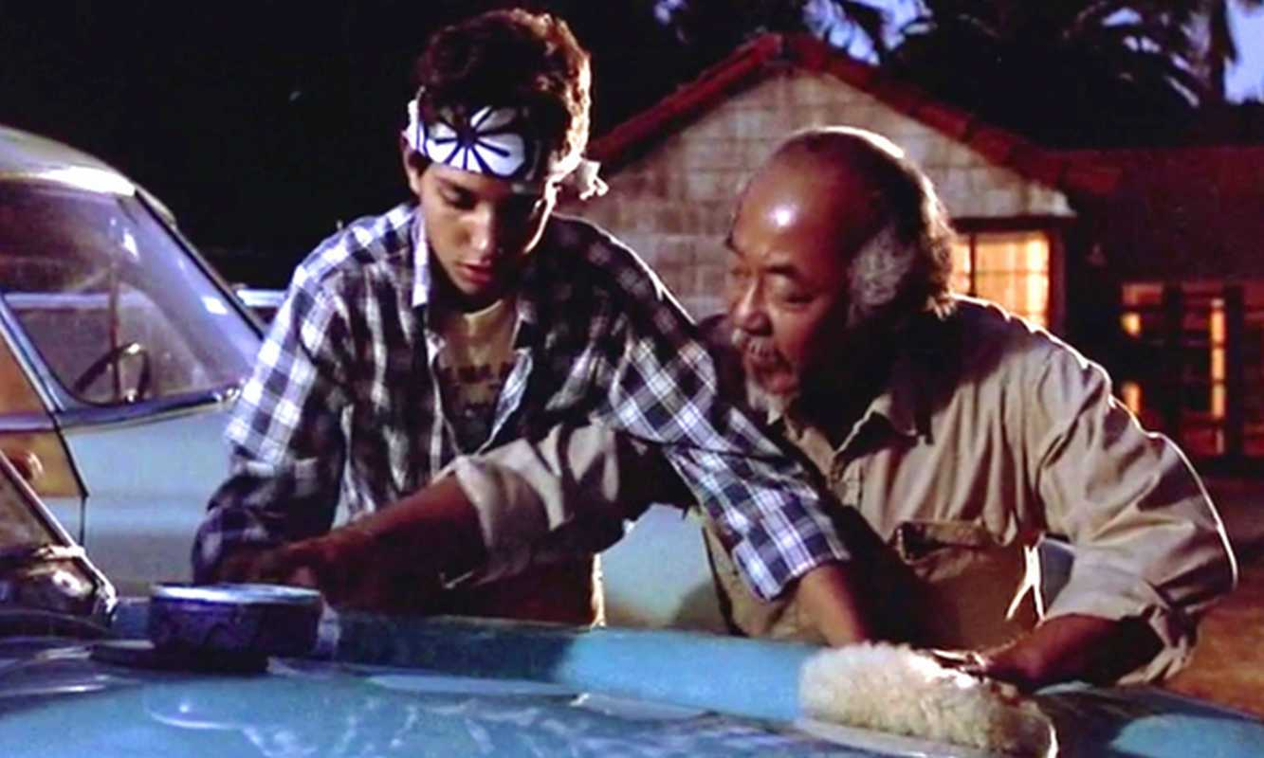


The “Miyagi” moment …

Slide 9
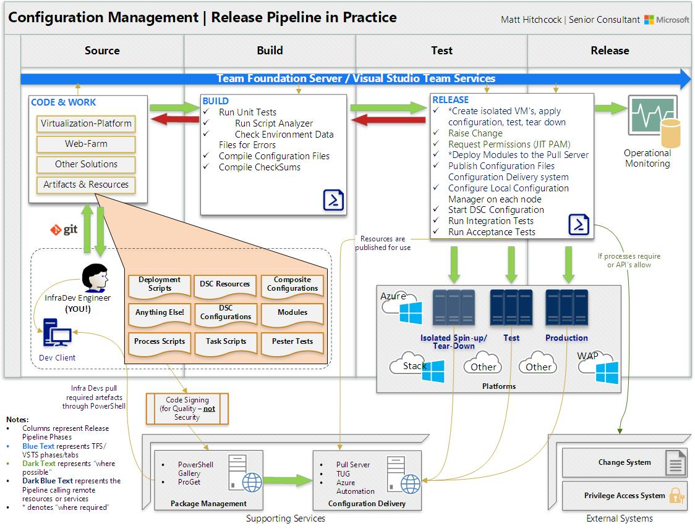

Slide 10
Demo – The Release Pipeline

Slide 11

How has the experience been?

Slide 12
Challenges to overcome …
Technical
How to manage Credentials
How to Orchestrate a Release
Environment issues!
DSC Resource Gaps
Locked down Desktop!
Change how we think about Infra
People
Prioritization of the project
Silent Resistance
Skills Development
Comfort Zone
Change how we think

Slide 13
Timeline of events
Month | What we achieved
Jul 2016 | Major Hyper-V issue prompts Infra-as-Code initiative
Aug 2016 | Simple demo of Infra-as-Code completed, no Release Pipeline
Sept 2016 | Spent time aligning understanding of Infra-as-Code among the team. Delivered a Demo using TFS Release Pipeline
Oct 2016 | Started teaching Git, DSC and TFS to Engineers. Started tackling Release Pipeline problems
Nov 2016 | Working DSC Configs for Web Servers, App Servers and Hyper-V Servers. Simple tests in place.
Dec 2016 | Tackled WAP Cloud Provisioning and SCVMM Config using Script Resource
Jan 2017 | Further development and testing of the Hyper-V and SCVMM Configuration on Test Servers
Feb 2017 | Pester Tests to prove Security Baselines are in place – Integrated into Release Pipeline and Builds
Mar 2017 | Production Pilot of TFS Release Pipeline, fully completed Web and App Server configurations. Overcame final Release Pipeline build challenges (holding pattern logic)!
Apr 2017 | Nano Server standard baseline completed. First full release of virtualization platform released! to be demo’d for Release when I return from PSConf.EU!

Slide 14

Summary
The Release Pipeline Whitepaper and Demo_CI Project are great resources to get started
This is likely to be a slow process, you will have additional challenges to solve
A clear architecture helps all involved
You can‘t tackle all the challenges, especially the people challenges at once. Take the wins as they come
Be prepared to feel lonely and to upset people along the way
Don‘t be a purist on day 1

Slide 15
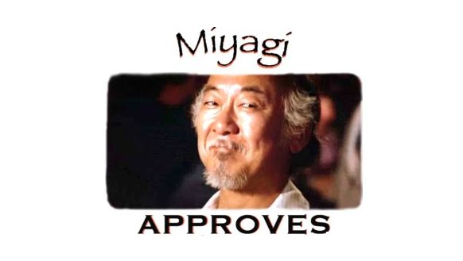

Slide 16
Next Steps...
Now: 15 min break
Grab a coffee
Stay here to enjoy next presentation
Change track and switch to another room
Ask me questions or meet me in a breakout session room afterwards

Slide 17
Questions?

Slide 18
About_Author
Matt Hitchcock is a Senior Consultant at Microsoft. He is a former Cloud and Datacenter MVP.
Based in Singapore, Matt‘s team covers Secure Infrastructure for Asia Pacific and Japan.
Cloud & Datacenter | Cyber Security | Devices & Mobility | Identity & Security
Email: matthew.hitchcock@microsoft.com
Twitter: hitchysg_msft
GitHub: github.com/matthitchcock

